Slide 1
ENERGY CONSERVATION MEASURE IN HOTEL
Kaviya.M
VVCET

Slide 2
What is energy?
Energy is the power to change things. It is ability to do work.
Energy helps us do things. It gives us light. It warms our bodies and homes.
It cooks food and keeps milk cold.

Slide 3
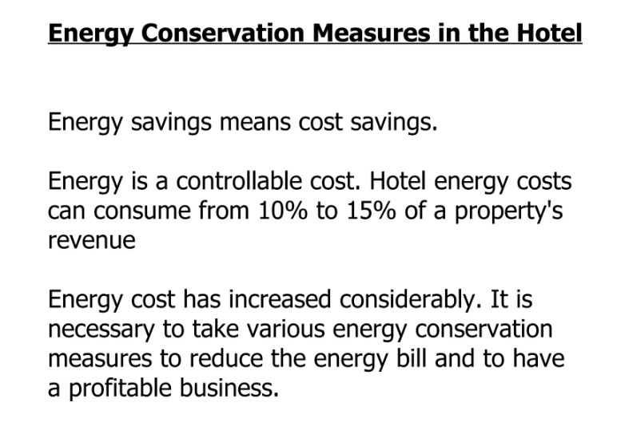

Slide 4
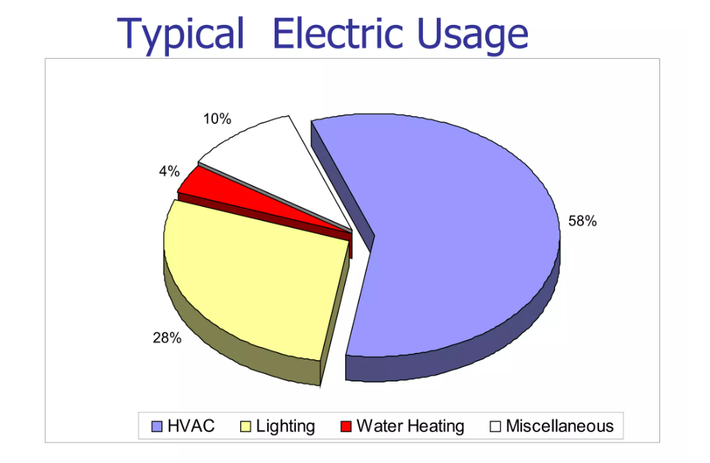

Slide 5
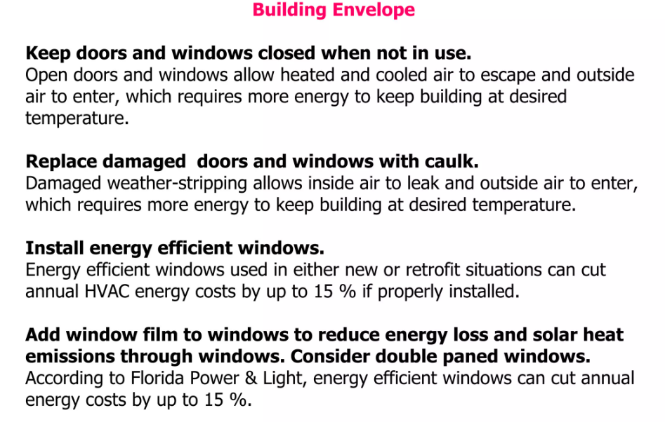

Slide 6
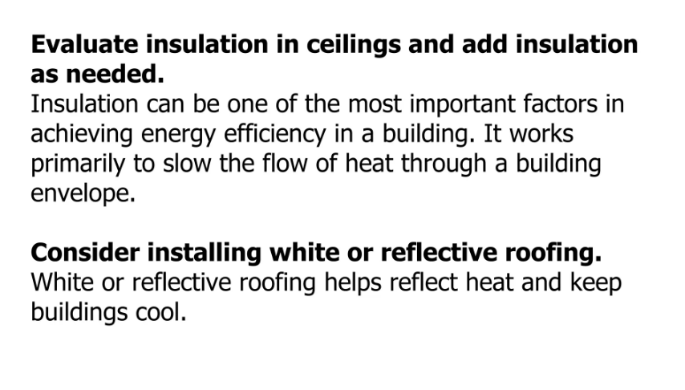

Slide 7
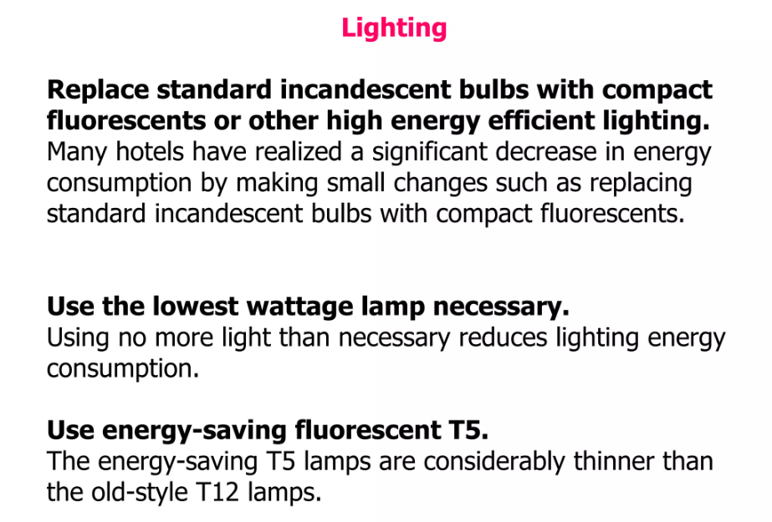

Slide 8
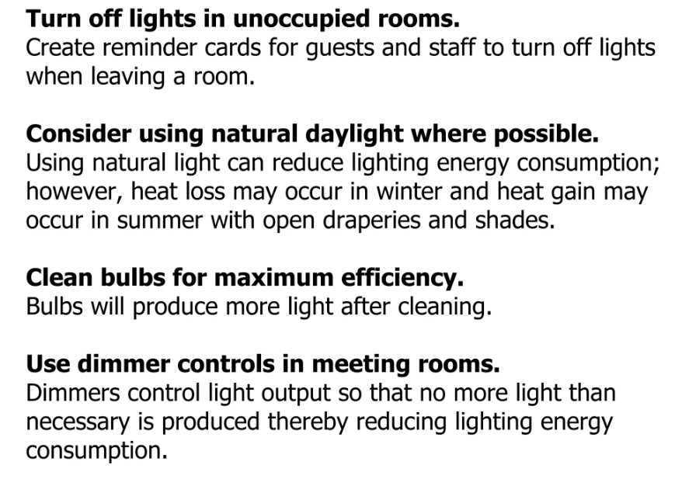

Slide 9
